Slide 1
AWS re:invent 2017 Highlights
by Atanas Kuzmanov
2018

Slide 2
Getting Started with Docker and Amazon ECS

Slide 3
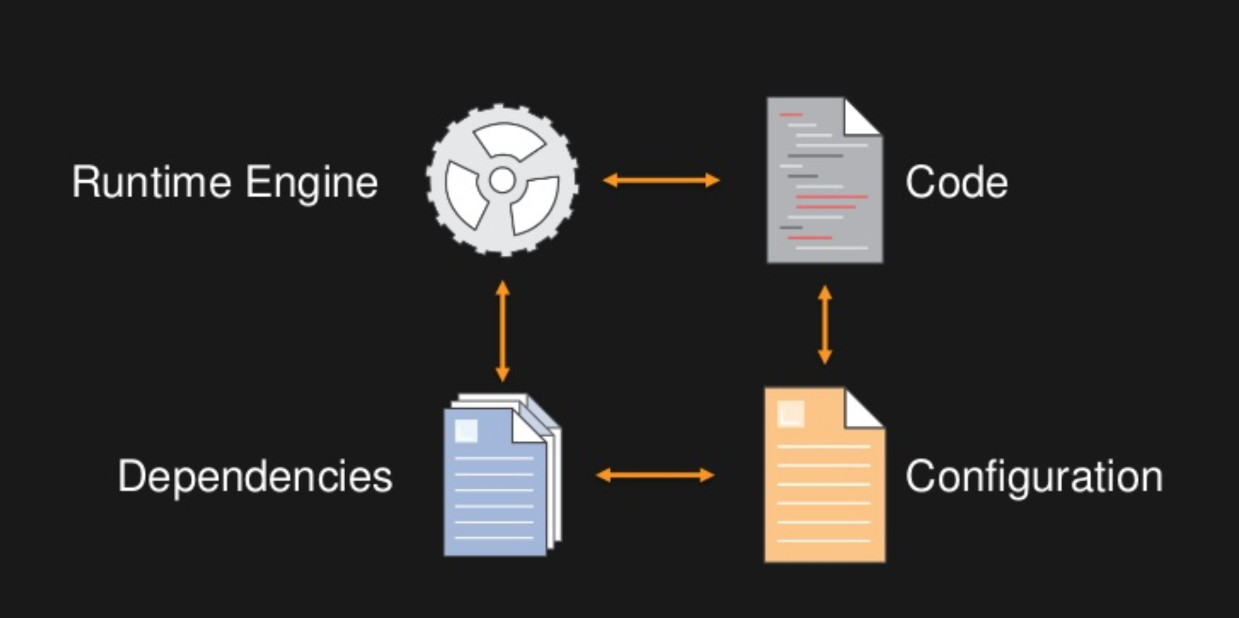
What is Docker?
Application environment components
Notes:
We are all familiar with the different pieces required for building an application.
Code – application code base
Engine – ngnix
Dependencies – NodeJS
Config – memory etc.

Slide 4
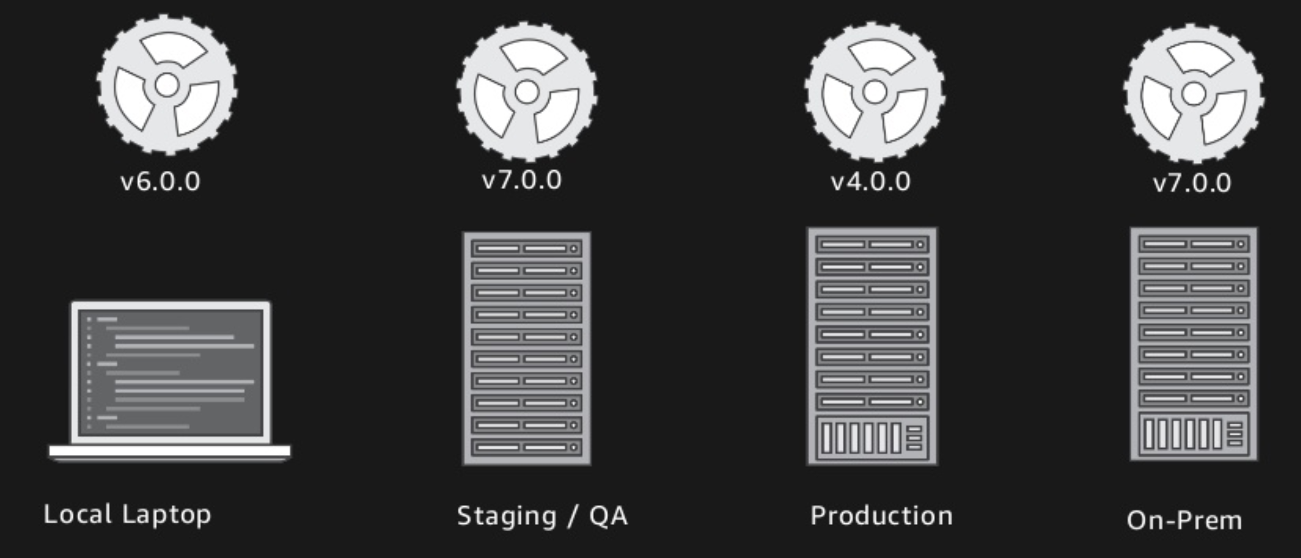
What is Docker?
Different environments
It worked on my machine, why not on production?
Notes:
Problems which often arise:
Version drift
Configuration drift
Dependencies drift
Example:
Dev has NodeJS v6
Staging and QA has v7 and runs fine
Prod has a machine which has been around for a while and has an older version of NodejS – v4 and the code crashes and burns
It’s a very disconcerting as it causes you to loose trust in your deployment lifecycle and whether or not you will be able to deliver an application to your clients.

Slide 5
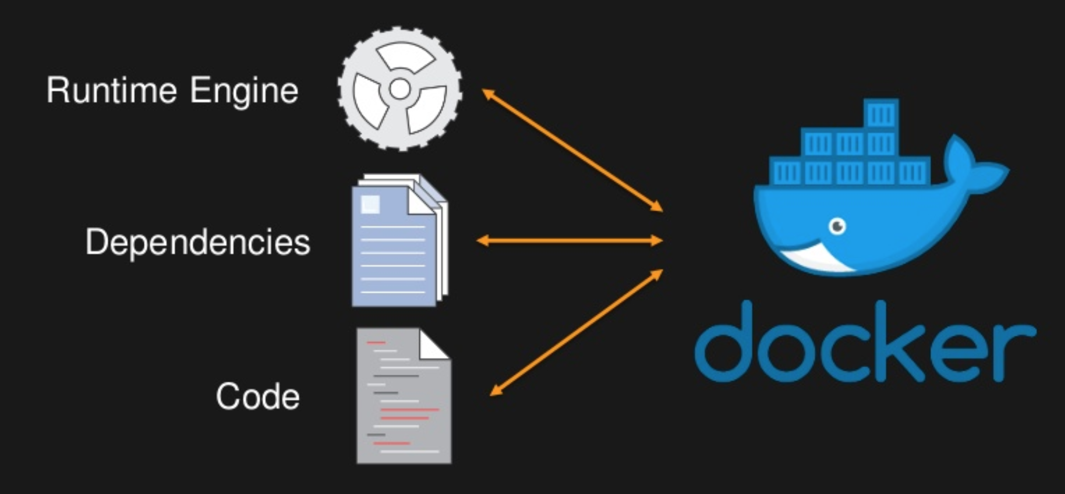
What is Docker?
Docker is the solution – packages all in a consistent unit of deployment.
Notes:
The solution is Docker.
It allows you to take your dependencies, run time engine and your code and package them in a consistent unit of deployment.
This artefact is somthing you can take to any machine or run locally and you can be confident it will run consistently.

Slide 6
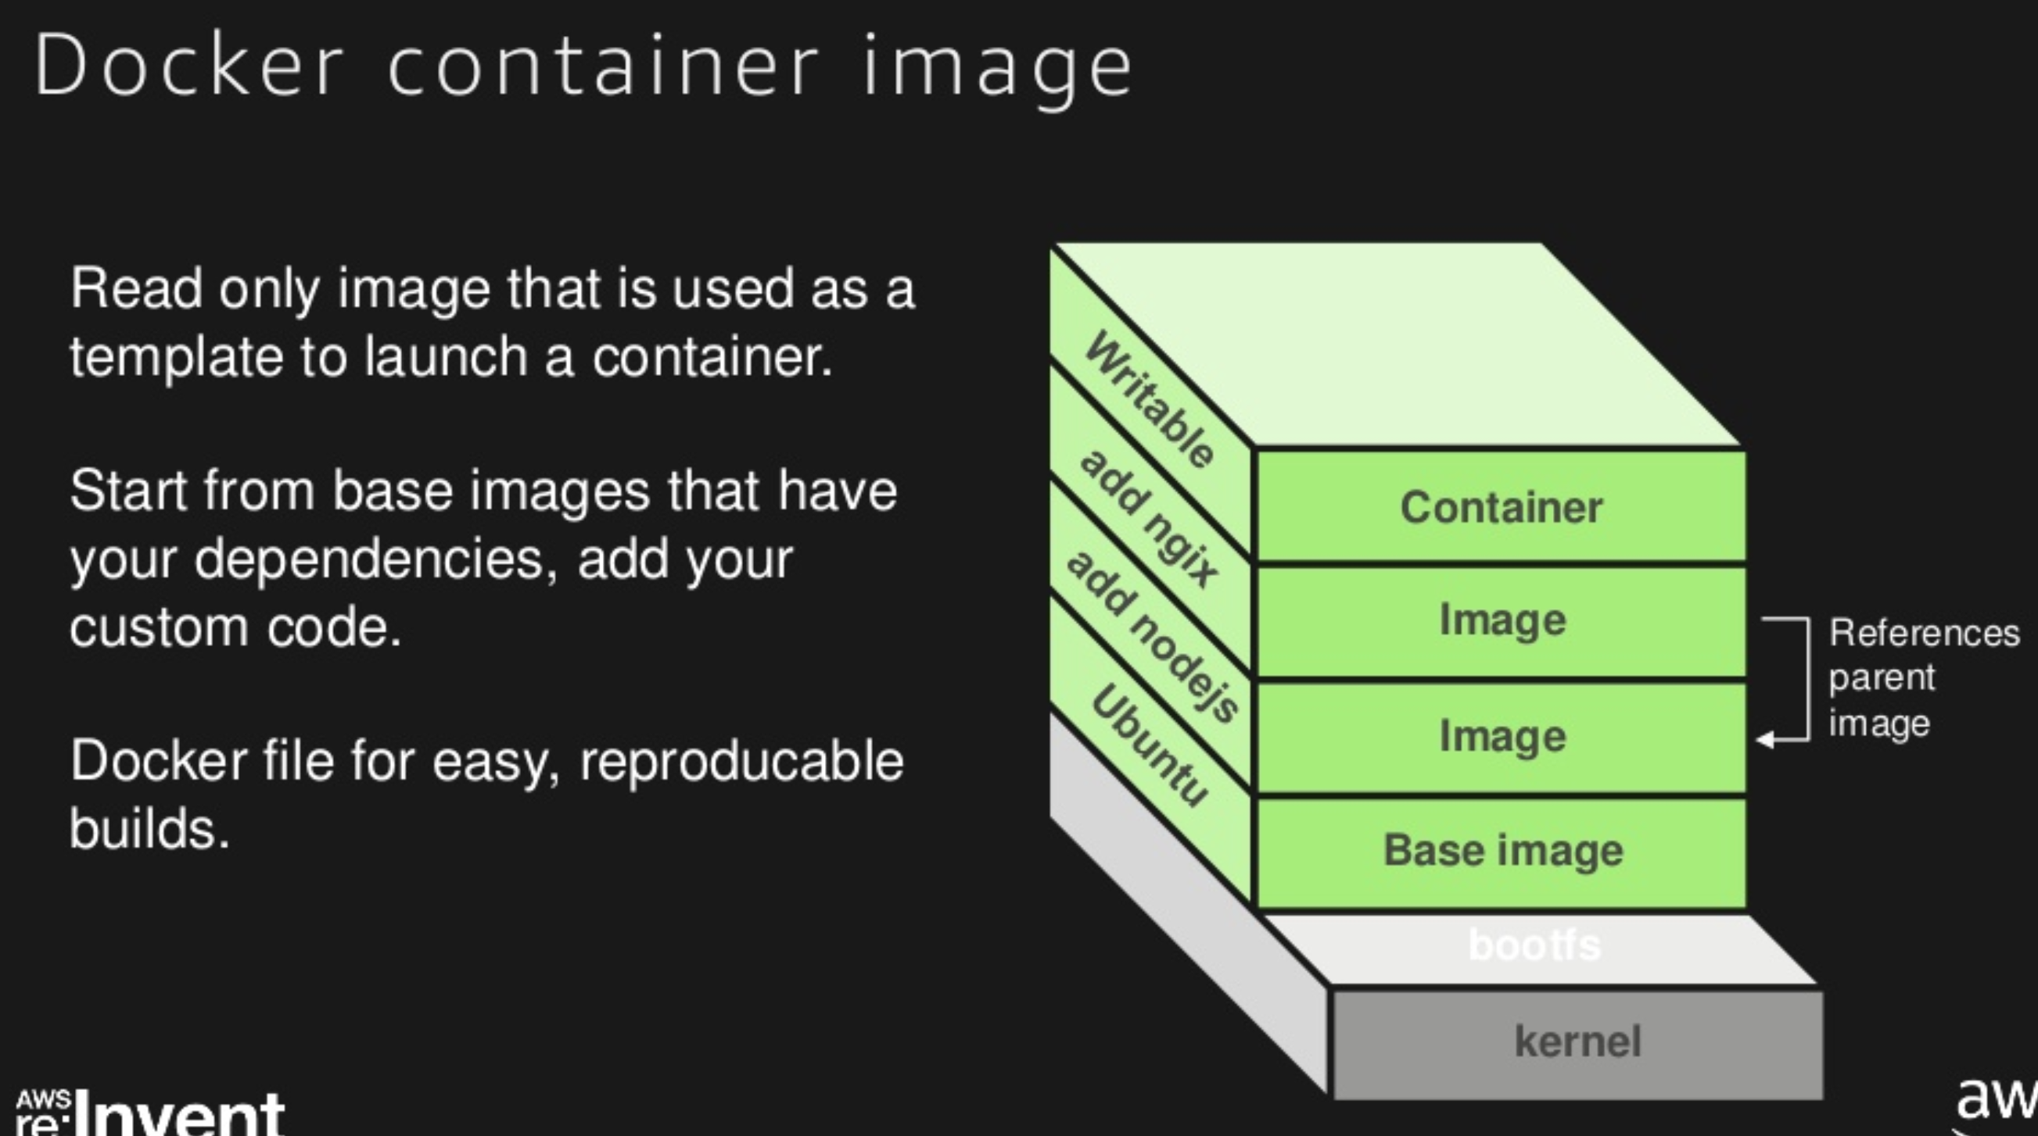
What is Docker?
Docker container image
Notes:
Docker image is build up from layers.
Each layer represents a part of your build process.
Kernel – boot
Base Image – adds system libraries for example for Ubuntu
Add 2 layer – NodeJS binary andgix binary
Writable layer – add application code here
Kind of working like with a git repo – commit – add stuff, add more stuf = end product = container image
Container vs. deploying on a virtual host etc.
SCP/FTP code base
Deploy new version
Install dependencies
Something fails -> need to do a roll back and try to get things the way they were
Hard as this could have mutated the machine in such a way that even the old version of the app would no longer run
And you will need to somehow rescue or provision a new machine
With docker the base machine is just an empty shell

Slide 7
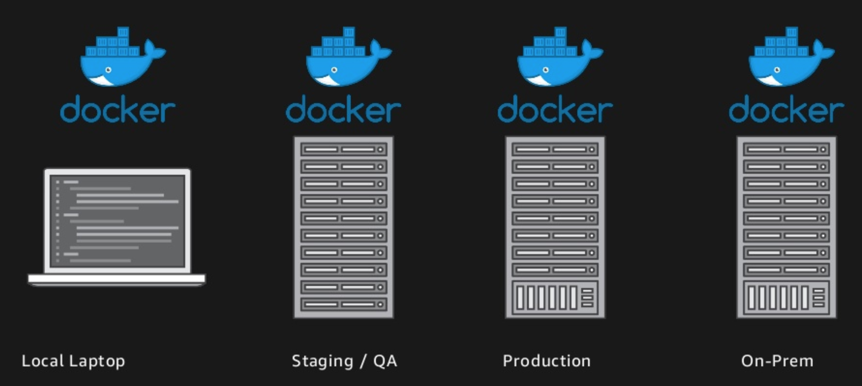
What is Docker?
Consistent across all environments
Notes:
When you deploy a docker image in runs the same across all envs.

Slide 8
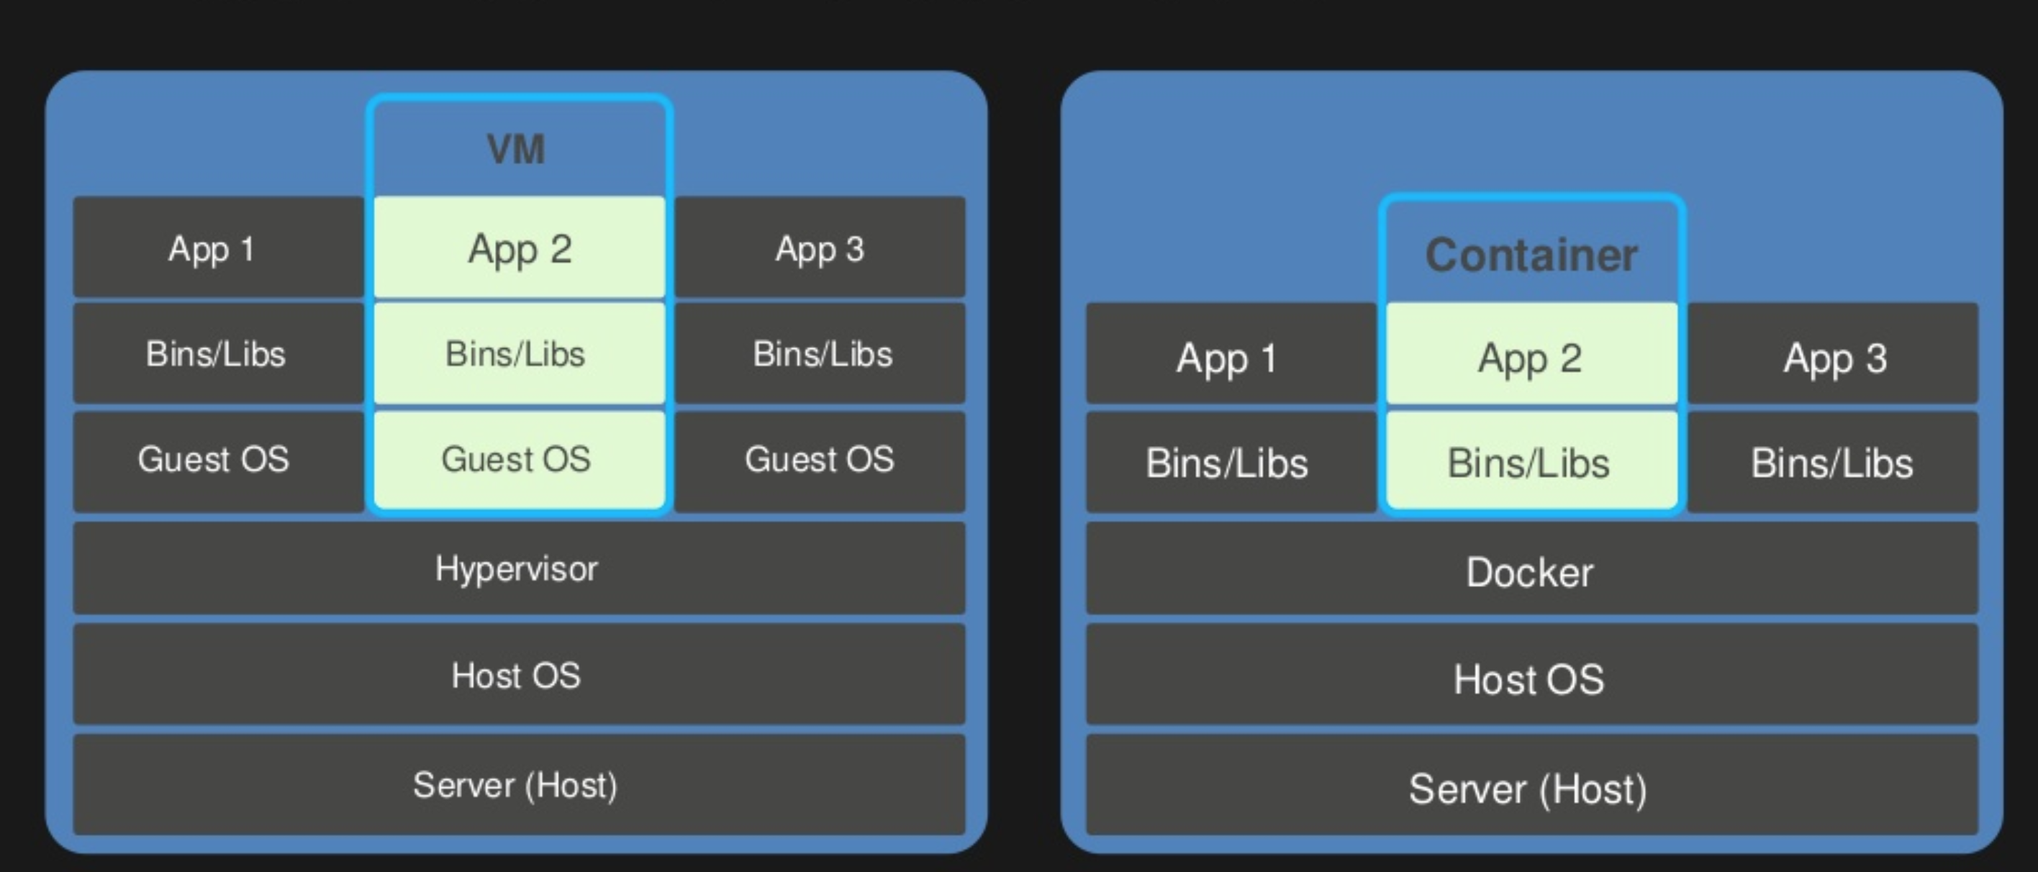
What is Docker?
Virtual machine versus Docker
Notes:
You may think well the benefits of docker sound very similar to those of an AWS AMI machine.
There is difference.
AMI image is much more
heavy weight – larger – often gigabytes
Due to the way it runs there is more overhead
It takes longer to generate
Vs
Docker image
Light – can be as small as 50 - 70mb – contains just application binaries and bare minimum requirements to run it
Because of this you can run multiple containers on the same EC2 before you run out of resources such as memory etc. They are more like processes – you can run 10, 15, 20 on a midsize instance.

Slide 9
What is Docker?
Container & Docker benefits
Portable application artifact that runs reliably everywhere.
Run different applications or application versions with different dependencies simultaneously.
Better resource utilization by running multiple lightweight containers per host.
Notes:
It gives you confidence you will be able to repeat the build across multiple environments and confidence that that code you built will run in production.
It gives you this…
- 1 –
2 – one can run NodeJS4 and the other can run NodeJS6 and they are not conflicting as they are not sharing the root base file system
3 – packing an instance with multiple containers and fully utilizing it’s resources

Slide 10
AWS Elastic Container Service (ECS)
Introduction to AWS Elastic Container Service

Slide 11
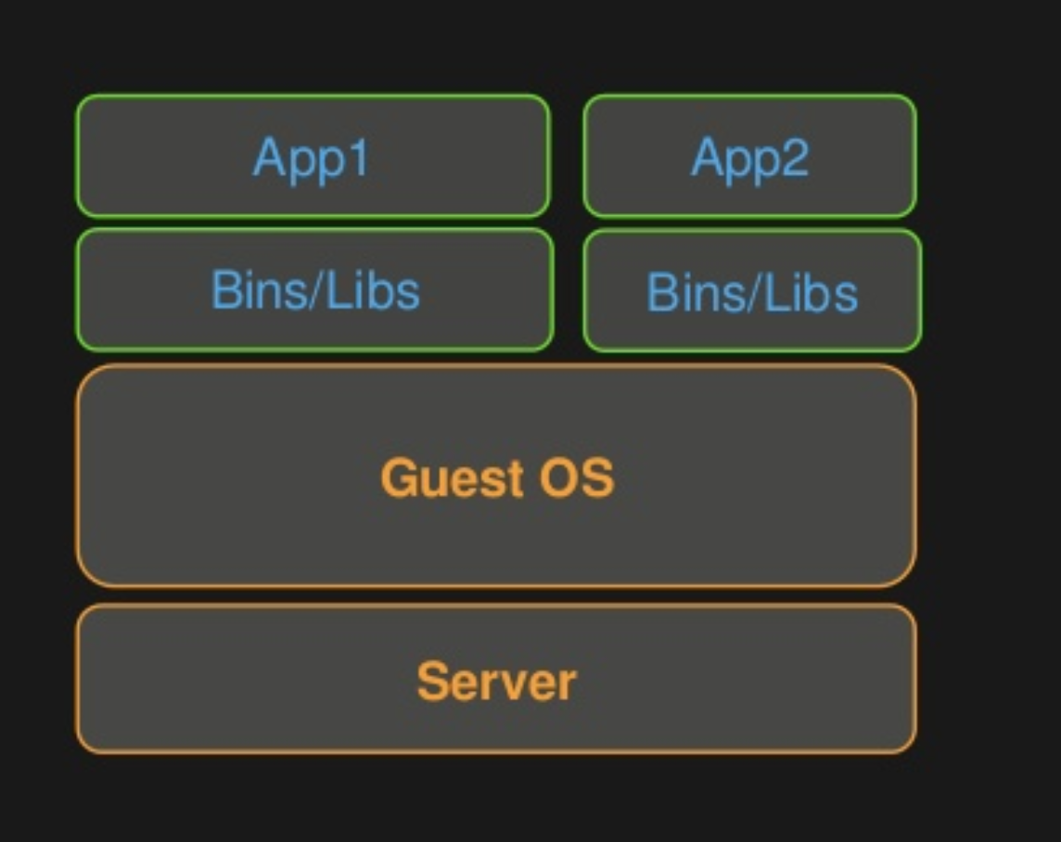
AWS Elastic Container Service (ECS)
Running a single host is easy
Notes:
When it comes to Docker running single host is easy.
Can easily use commands on a docker container running on one machine.
Docker start
Docker ps – list all docker containers on that machine
Docker stop
Easy to manage containers on a single host, run them, check their status.

Slide 12

AWS Elastic Container Service (ECS)
A few hosts?
Notes:
Most often the use case is people want to run a variety of hosts, a very large cluster of hosts.

Slide 13

AWS Elastic Container Service (ECS)
Many hosts? – How do I distribute my containers across gigantic clusters?!
AWS customer 1 – 3500 instances at peak
AWS customer 2 – runs a fleet of 1200 instances on average

Slide 14
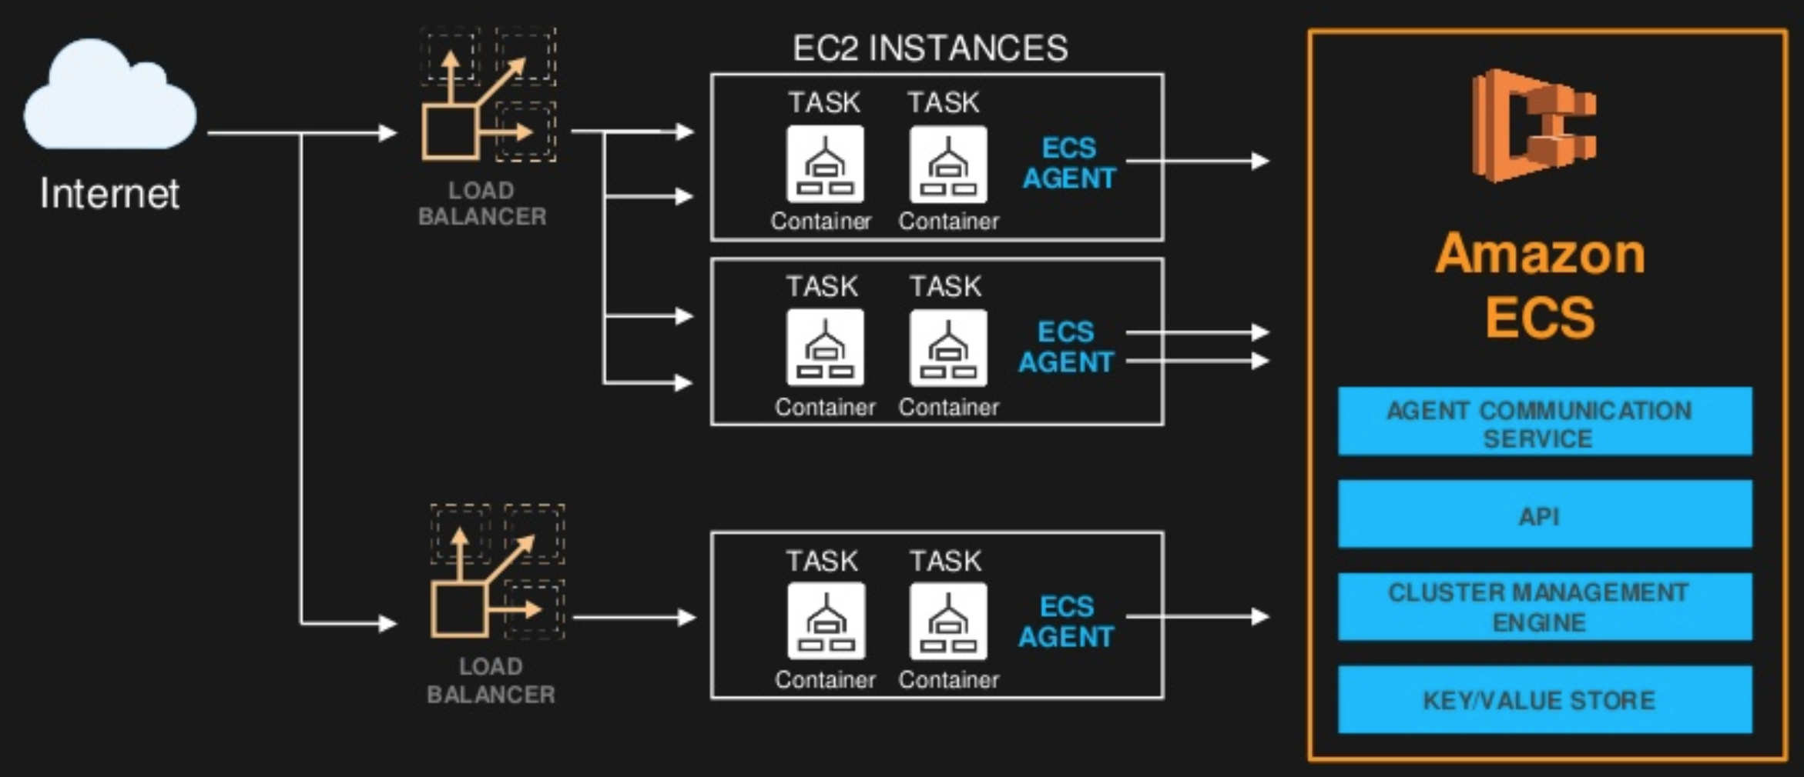
AWS Elastic Container Service (ECS)
Application
Notes:
The way the do this is by using AWS ECS.
Cluster of hosts running on EC2, you can run them in two ways
Run directly yourself
Use Amazon Fargate – serverless containers
On the machine there is an ECS agent. Controls what happens on that machine on your behalf – if you wanted to do it yourself you would ssh and do it manually but you do not want to do that.
ECS agent – running on a EC2 machine – controls containers – start, stop, get stats etc. doing it on your behalf without manually SSH
At the top lever there is an API, which is what you use to interact with the cluster as a whole. Eg. I want to run 4 copy of this app container across 3 availability zones and I want to run them on m3.medium instances. ECS will take this high-level command and find ways to place tasks in the cluster to fulfill it.
API – high level apiexample, interact with the cluster as a whole, communicates & instructs the agent
Run my containers on t2-small instances
Run this container with a particular IAM role and a second one with a different one
The Container task is what ultimately gets placed on the instance
Its one step above the container – the container is the application
Task is the application + the config of how you want to run the app – does it need disk access, env virables?
Load balancer
Traffic to the containers
You can run a container which is just running a job to completion, but the more interesting task is running a service you want to run continuously and receives web traffic
AWS ECS will configure a load balancer on your behalf as well as place the task on instances in your cluster; when it places a task it also reconfigures the load balancer to direct traffic to that task. Hands free – no manual intervention.

Slide 15
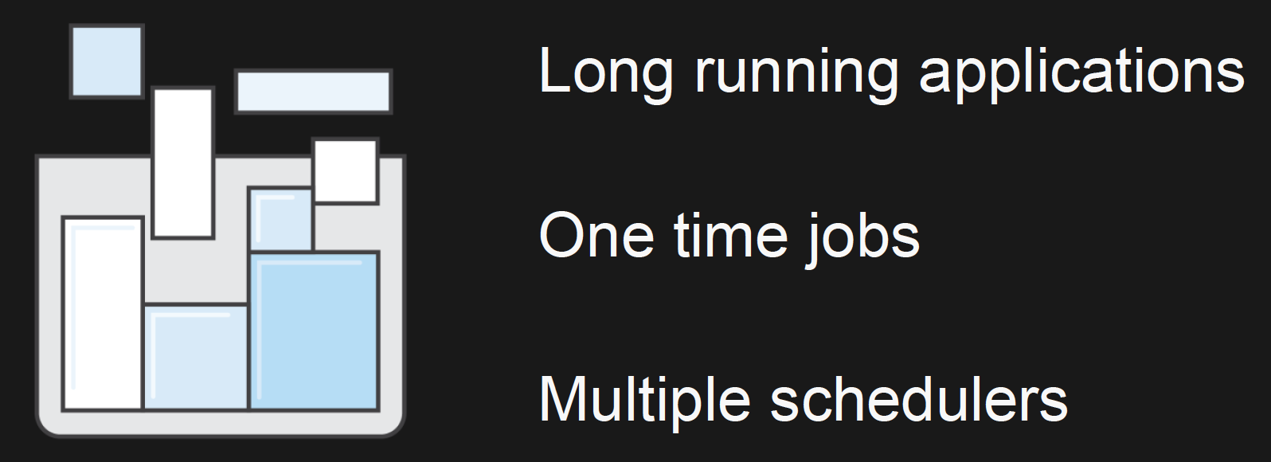
AWS Elastic Container Service (ECS)
Designed for many use cases
Notes:
1 – by asking AWS ECS to keep 3 copies of this app running of all time, so if one of them crashes it will restart
2 – I want to run this particular bash job to extract some data from a database, run it one time somewhere in the cluster, don’t care where inside, as long as it runs.
3 – You can have a scheduler running a data, efficiently and these can run alongside other schedulers which are doing things such as running the app persistently.

Slide 16
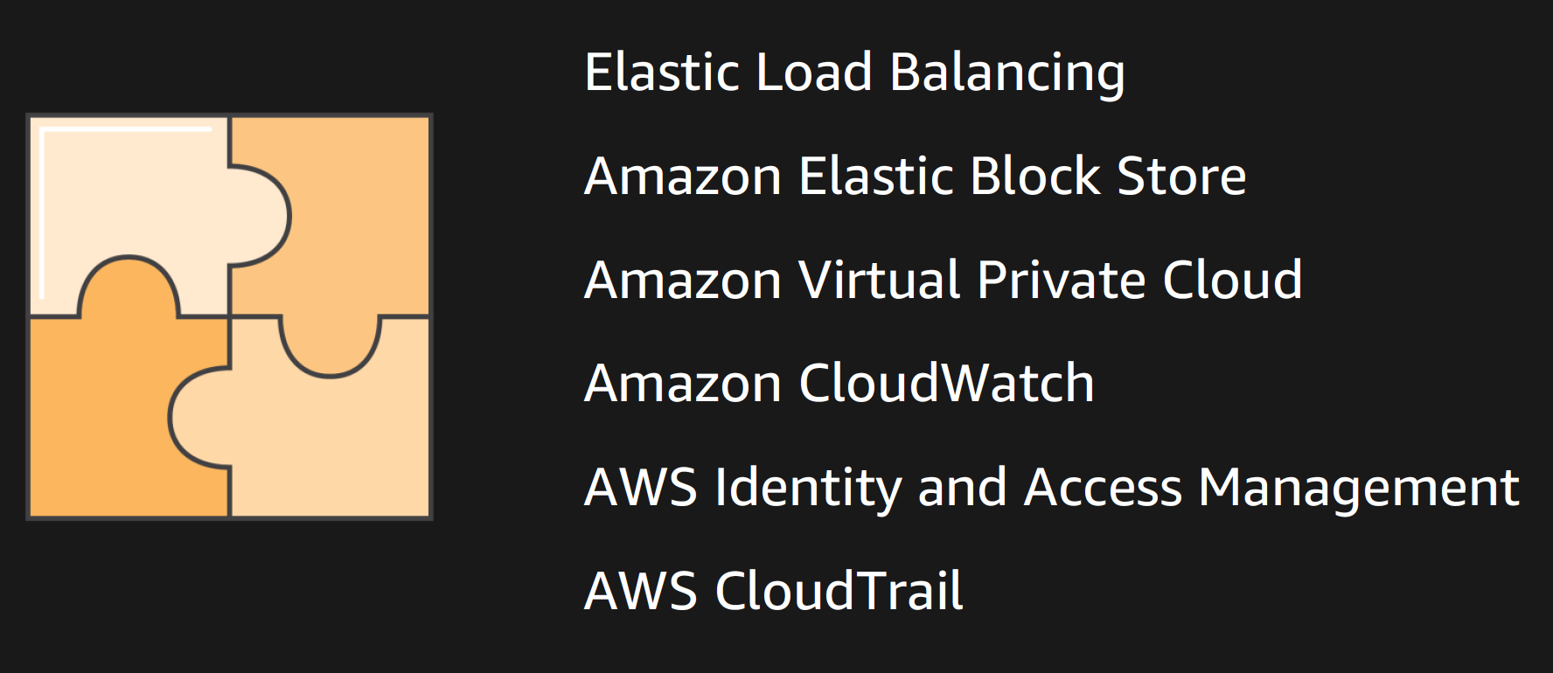
AWS Elastic Container Service (ECS)
Designed for use with other AWS services
Notes:
Integrates really well with the following:
1- ELB
2 – EBS – storing date
3 - prevent from being accessible to hackers
4 – metrics, cpu, memory, logs etc.
5 – IAM – allow different processes on the same machine different access – eg password service will only have access to the password db, but not other services
6 – CloudTrail – auditable log of everything that happens on that machine, actions people have taken to launch or run things in the cluster.

Slide 17
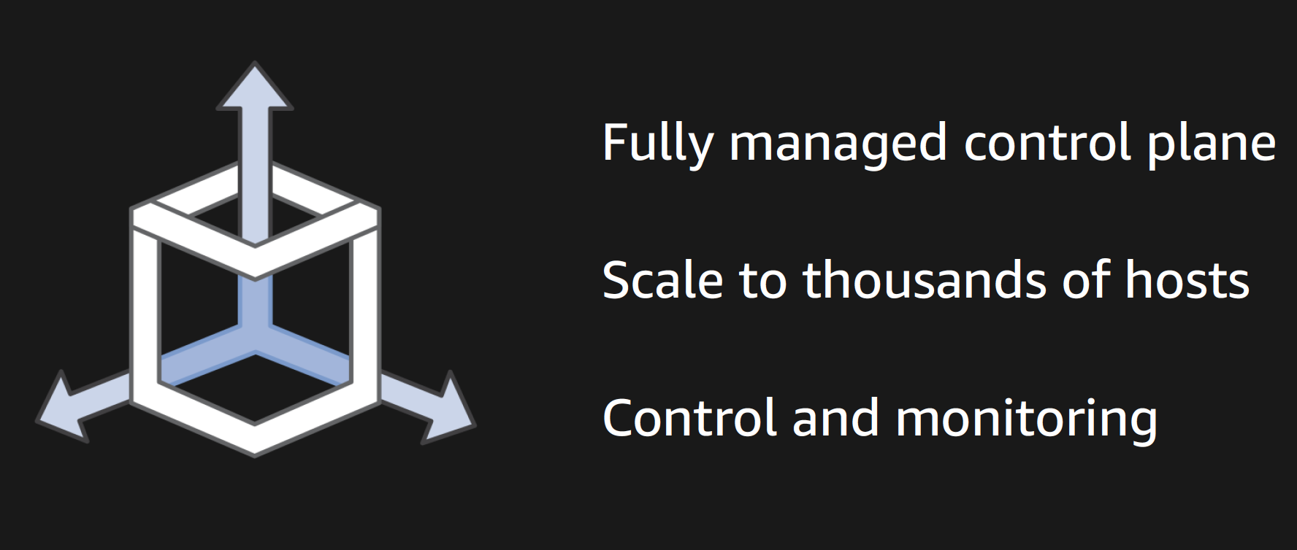
AWS Elastic Container Service (ECS)
Designed for scale
Notes:
Designed for massive scale.
Seamlessly scale up to thousands of hosts.
Even though the scale you still have full control and monitoring of what happens inside the cluster.

Slide 19
Amazon Rekognition Video

Slide 20
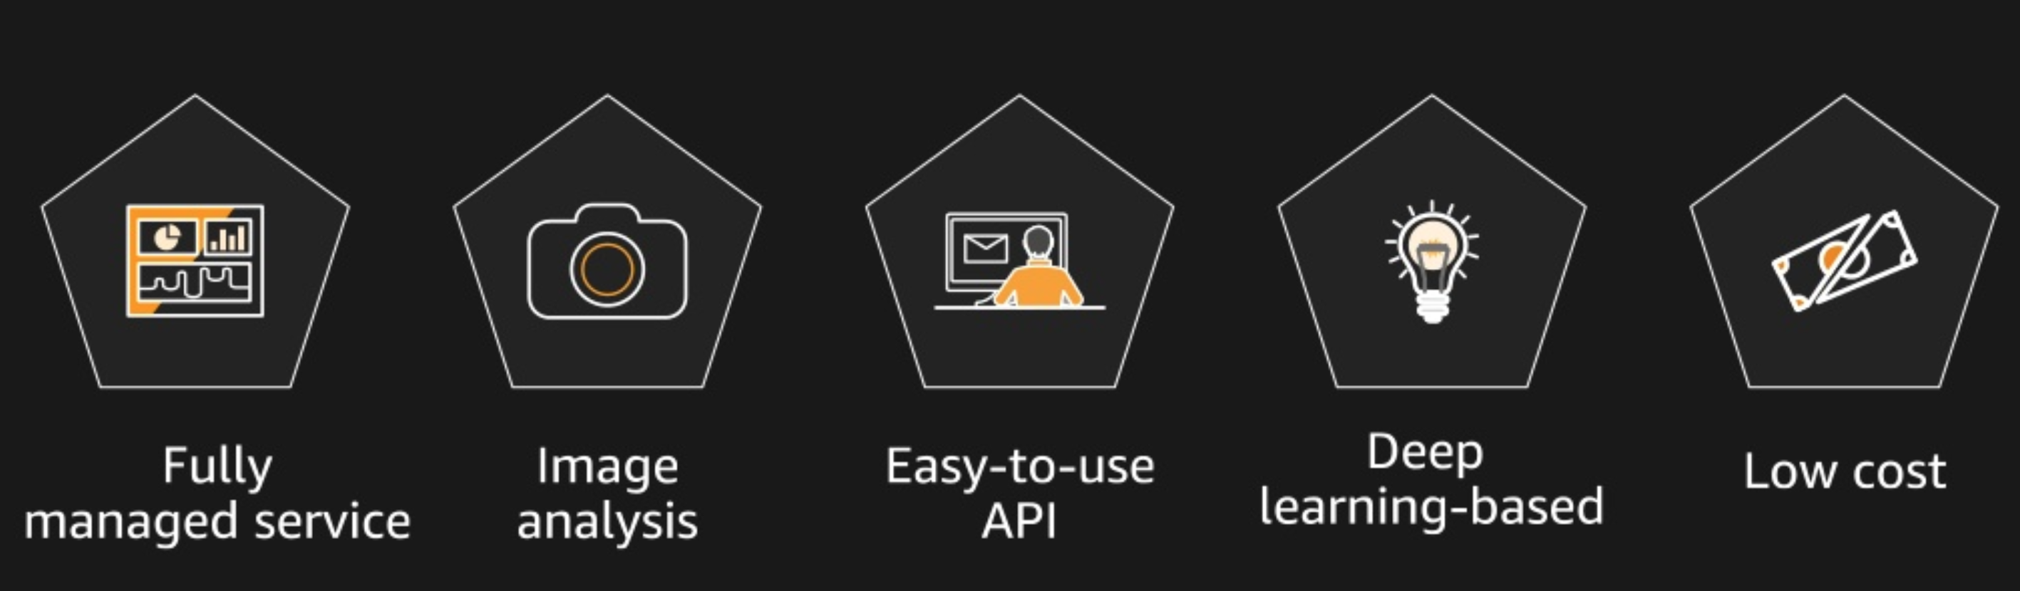
AWS Rekognition Image
Launched last year with the following features
Notes:
Launched at aws re:invent 2016 last year with features such as:
Image recognition
Object detection
Face recognition

Slide 21
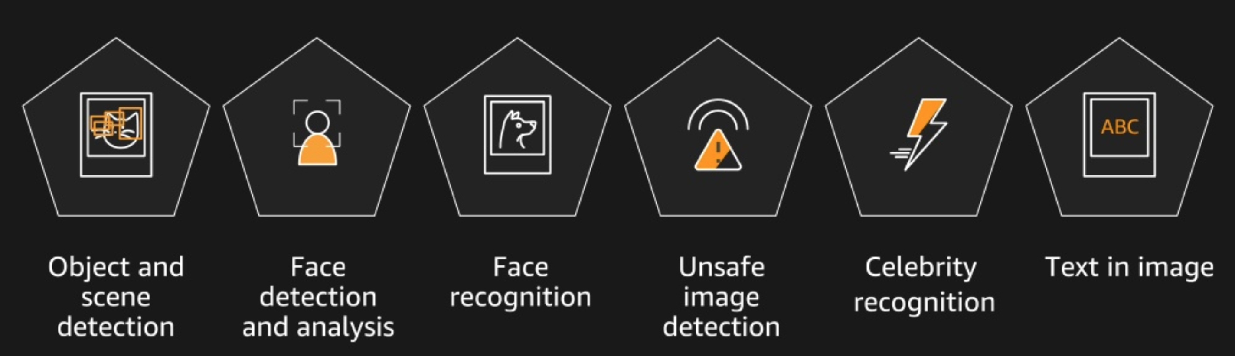
AWS Rekognition Image
Since then more features have been added
Notes:
Since then more features have been added such as:

Slide 22
Videos and video streams
Essential
Media and entertainment
Video-on-demand viewers are expected to reach 209 million by 2021 globally
Public safety
CCTV content is expected to grow to 859PB/day
(~200 000 000 one sided, single layer, DVDs per day)
Smart homes
45 million Smart Home systems are expected to be in use by 2018
Notes:
Customers asked what is AWS’s answer for video?
Why? – Because video content is growing rapidly.

Slide 23
Video analysis
Necessary
Enhance overall safety and security
Improve business operations and productivity
Improve customer experience
Notes:
Why is video analysis important for AWS’s customers?
Visual analysis improves:
Enhance safety at work
Improve logistics or customer experience in retail – track flow of people in stores; people’s feelings do they need customer service, direct flows
Smart home – deliver personalized safe and secure experience for customers

Slide 24
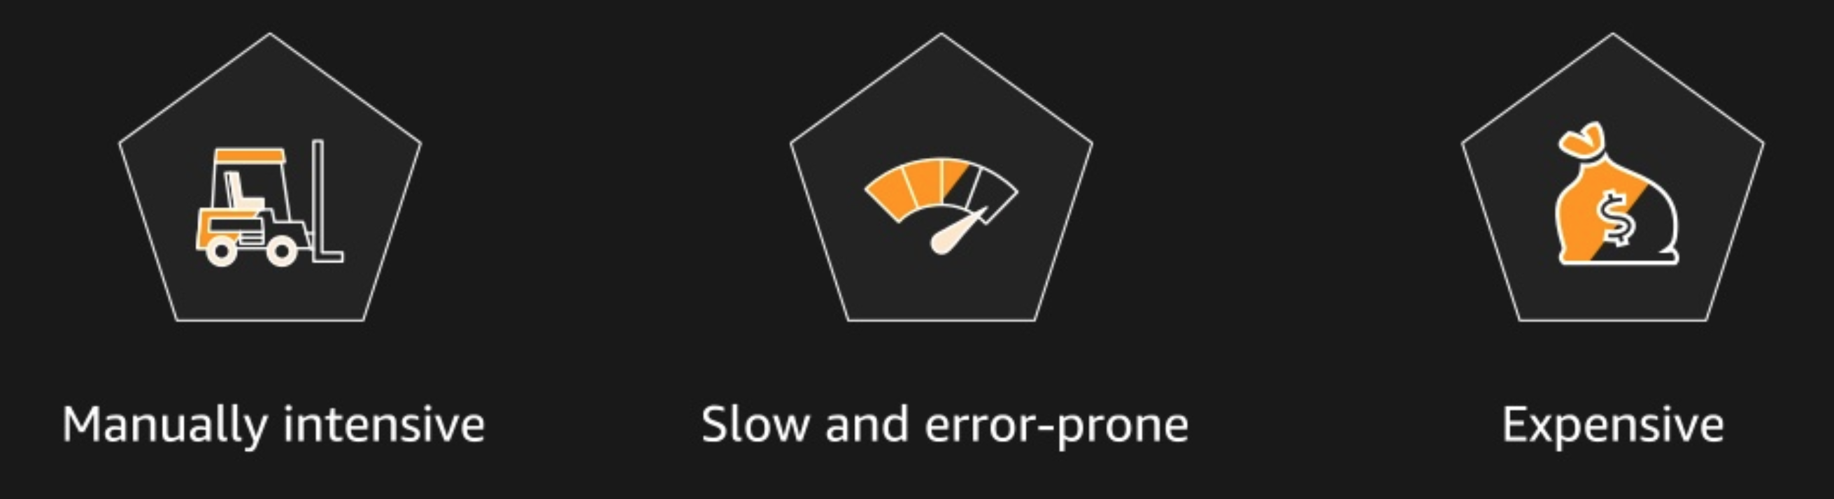
Limitations of current solutions
Notes:
Video processing is still very manual.
A lot of manual reviews and checks of the data
Because of human intervention the process is slow
Expensive
Also context is different – many different types of weddings all over the world depending on tradition.

Slide 25
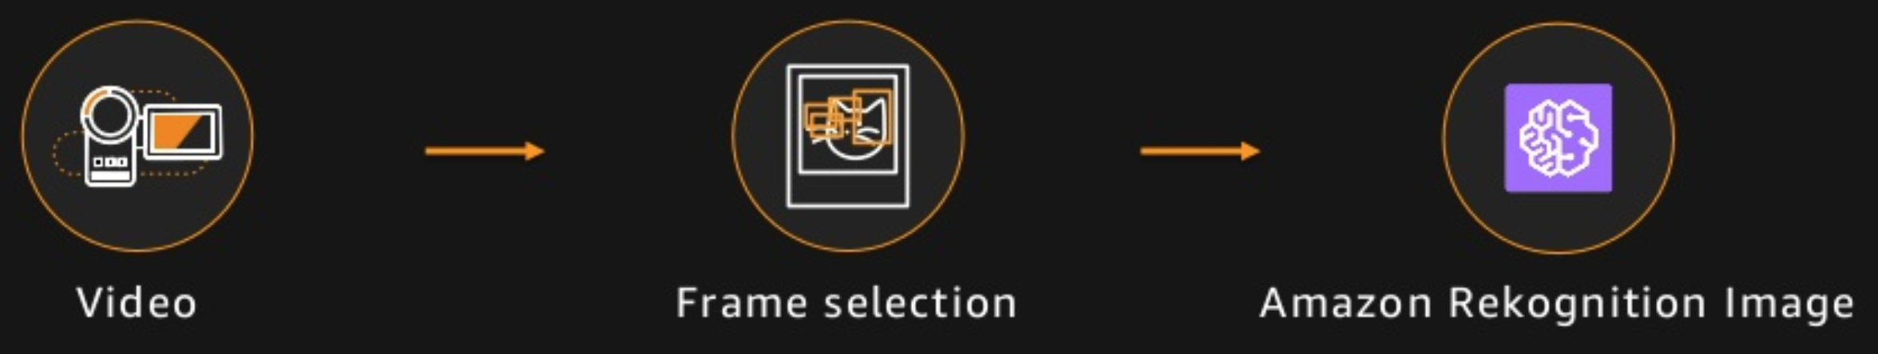
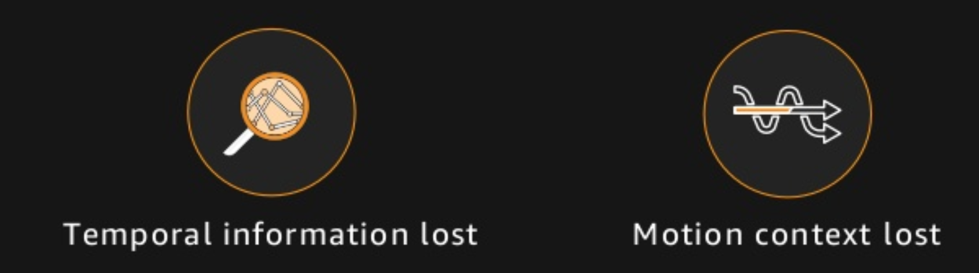
Current solutions
Limitations
Notes:
A company wanted to recognize and annotate politicians in videos (about 90 000 politicians in USA).
They were spending 10 000 of man hours to manually annotate politicians.
Took the video and frame by frame sent it to AWS Rekognition
Loss of:
Temporal information
The fact that I moved from A to B is lost
Motion context
Camera is still and people pose for it.
Video captures motion.
Image analysis – frame has worse quality, more noise, therefore misses out on details which a photo would have

Slide 26






AWS Rekognition Video
Features:
Object and activity detection
Person tracking
Face recognition
Real-time live stream
Unsafe video detection
Celebrity recognition
Notes:
AWS Rekognition uses the entire context of the video
Visual – what?
Time – when?
Motion – how?
Object and activity detection
Objects – room, tv, chairs, people -> conference room
Scene – indoors
Activity – what is he doing, he is walking, the others are sitting
Person tracking
Able to track an individual even when they are partially or fully hidden for some time
If face is seen, it can track an individual even if they left and then came back to the scene
Public safety – different clothes do not matter
Face recognition
Against 10 000 000s of collections of faces
Real-time live stream
Analysis –
Unsafe video detection
Will tell where in video
Why it thinks it’s explicit or suggestive
Celebrity recognition

Slide 27
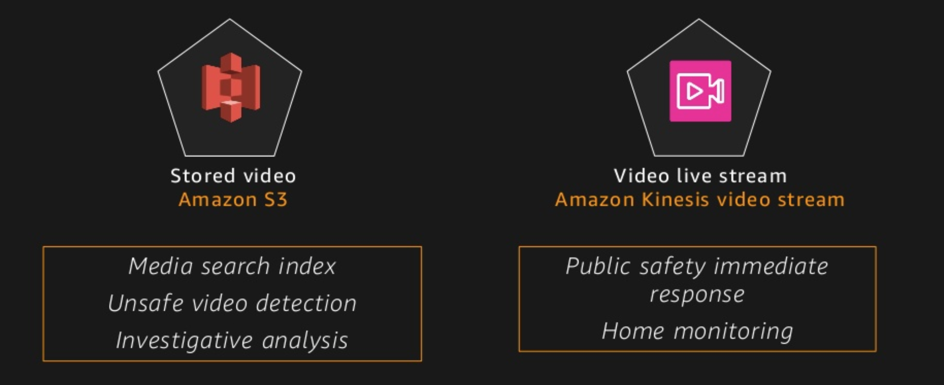
AWS Rekognition Video
One solution for all
Notes:
Solution for both stored video and live streams.

Slide 28
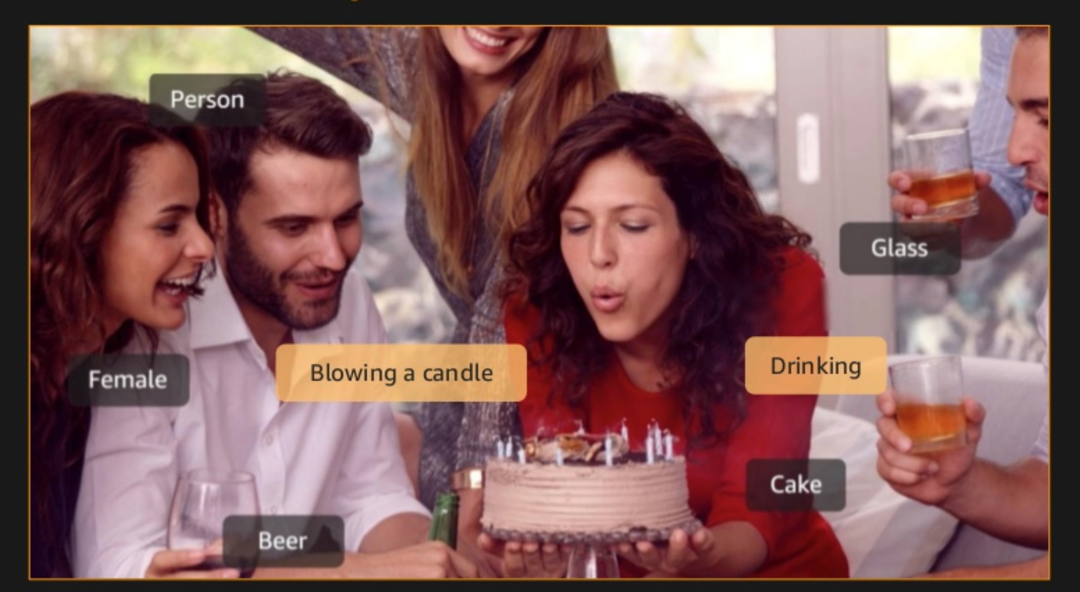
AWS Rekognition Video
Object, Scene and Activity detection

Slide 29
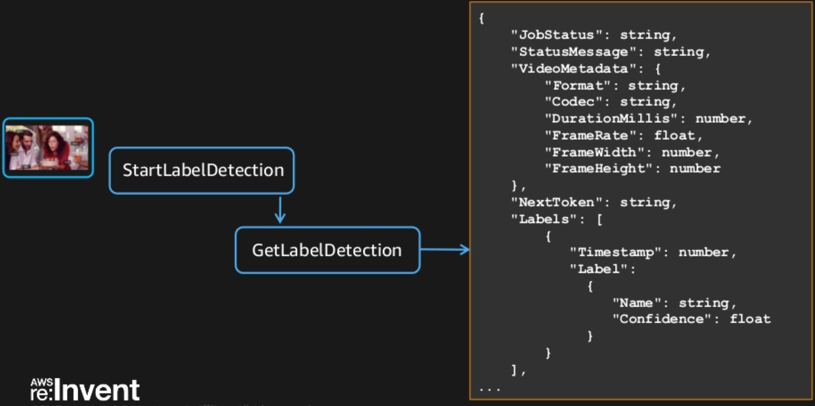
AWS Rekognition Video
Object, scene and activity detection
Notes:
Videos are quite hard to process since they can be very large.
They start an asynchronous batch analysis job, in this case label detection.
They provide you with a job id.
And if its running for a while you can come back and do a get label detection to get metadata.
If the job is still running you will get status back that it’s still in progress.
If complete you get 2 types of projection:
Natural time series projection
At time 0 this happened, this was found
At time 1 this happened, this was found
Or you can remove the time projection and get in order of appearance these are the things that happened and were found, including time when they happened or were found
As an input you can provide confidence percentage in order to filter results.

Slide 30
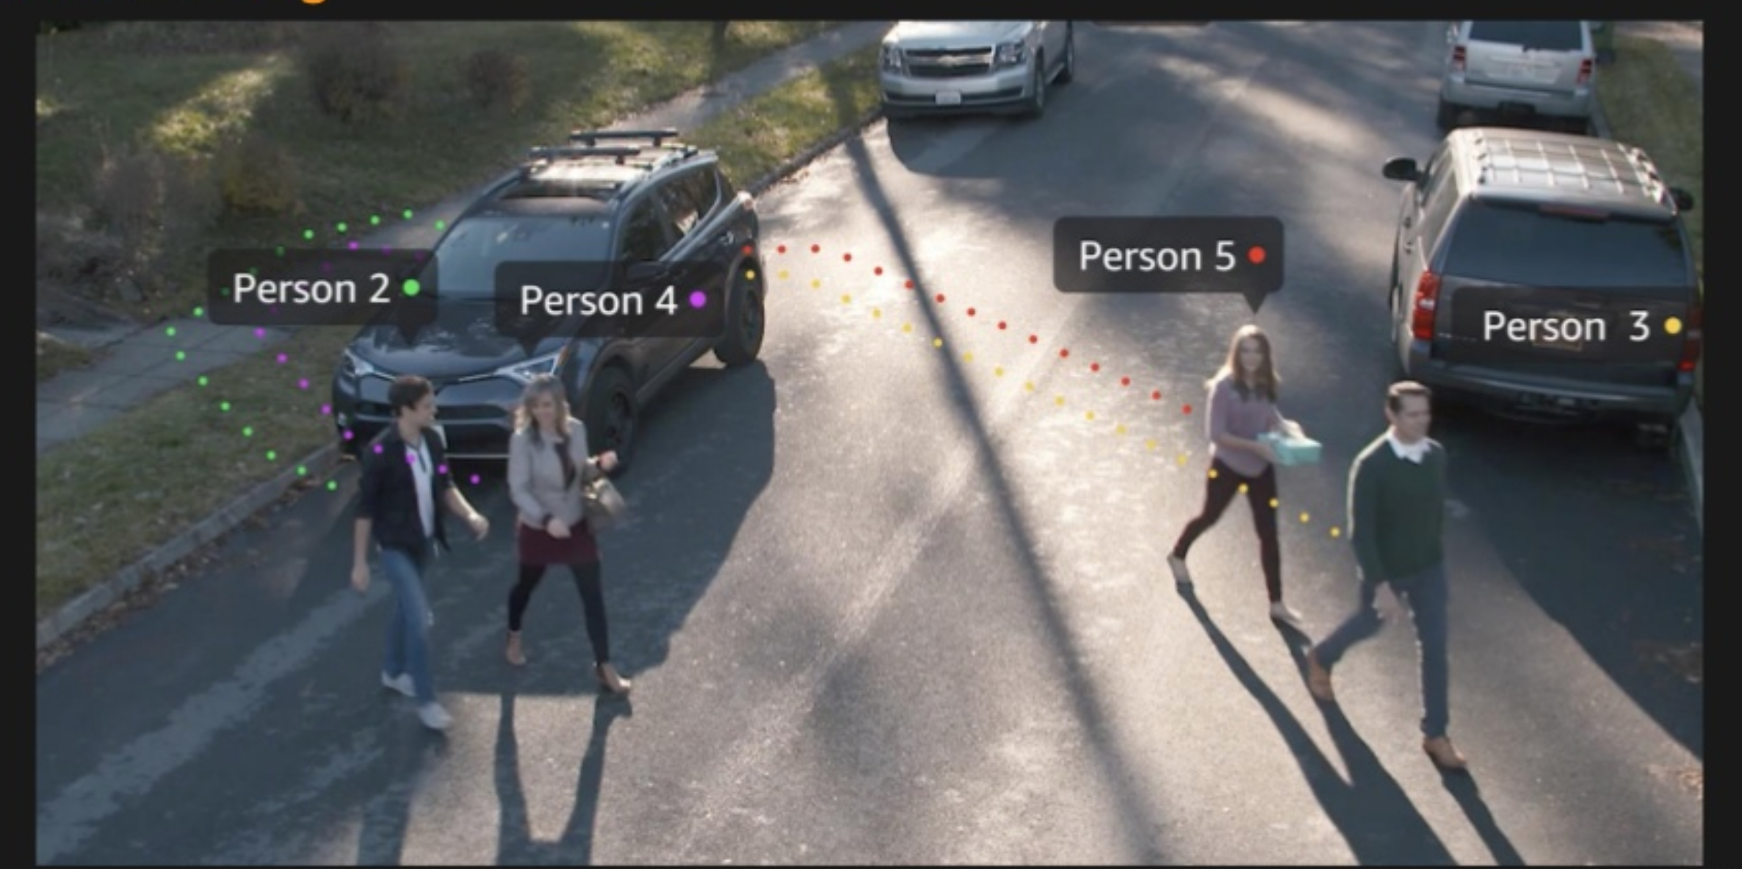
AWS Rekognition Video
Person tracking
Notes:
Works even when someone is only partially visible or leaves and returns to the scene.

Slide 31
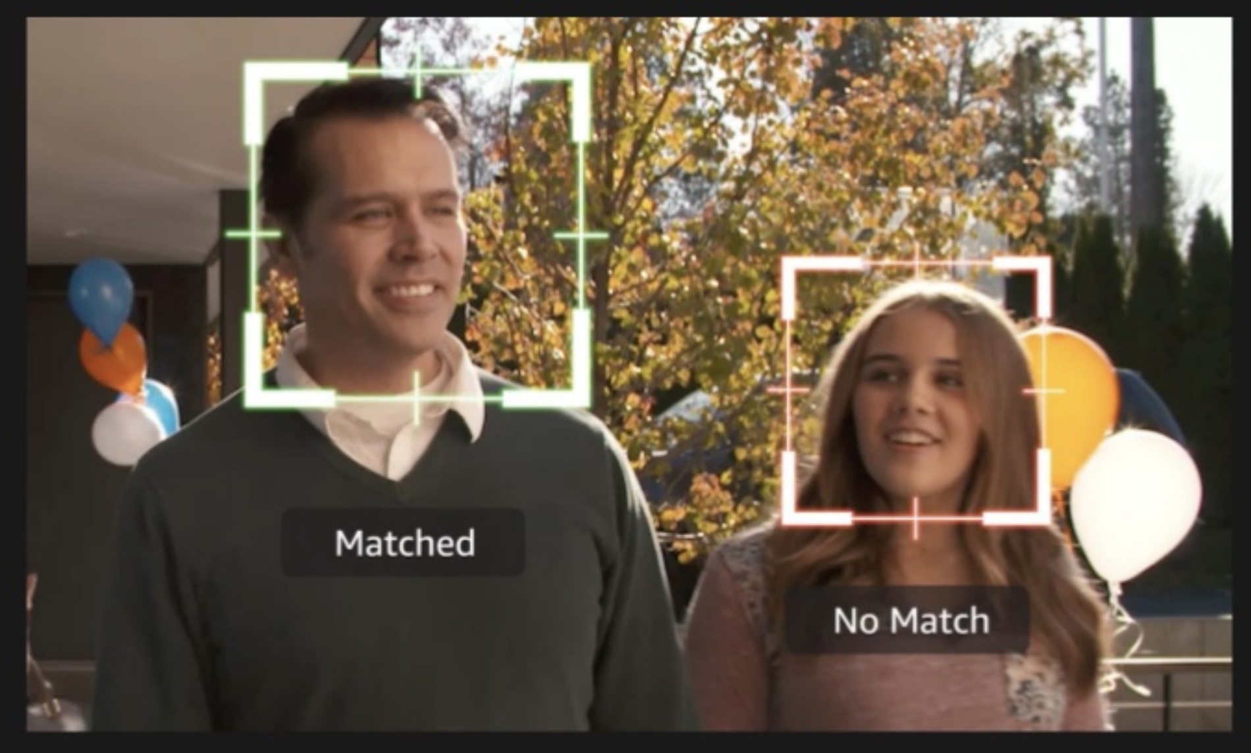
AWS Rekognition Video
Face search
Notes:
Able to match a face to a collection of faces.
If a person is missing, police can walk around with a camera strapped onto them and maybe find the missing person.
q

Slide 32

AWS Rekognition Video
Celebrity Recognition
Notes:
I think this could be very useful for the CPS team automatically tagging content.

Slide 33

AWS Rekognition Video
Unsafe video detection

Slide 34



AWS Rekognition Video
Media and entertainment
Create metadata for celebrities, emotions, key topics in videos with time segments for search or recommendation engines
Automatically detect inappropriate content, based on requirements
Extract data in streaming mode to enhance user engagement
Notes:
All of this provides solutions for media and entertainment.
Useful for Recommendation engines or ad placement
All this metadata shortens video search tremendously.
Enhance live streams by filtering or adding real-time annotating celebrities etc.

Slide 35
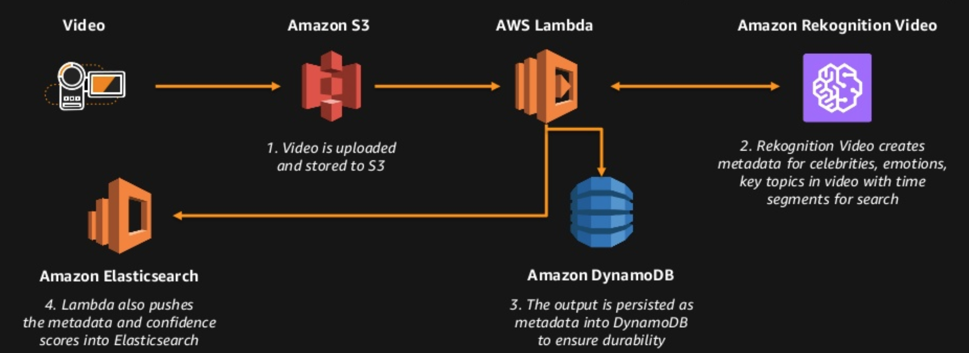
AWS Rekognition Video
Use case: Dynamic Video Search Indexing
Notes:
How would you create a dynamic search index?
Example of a dynamic search index infrastructure.

Slide 36
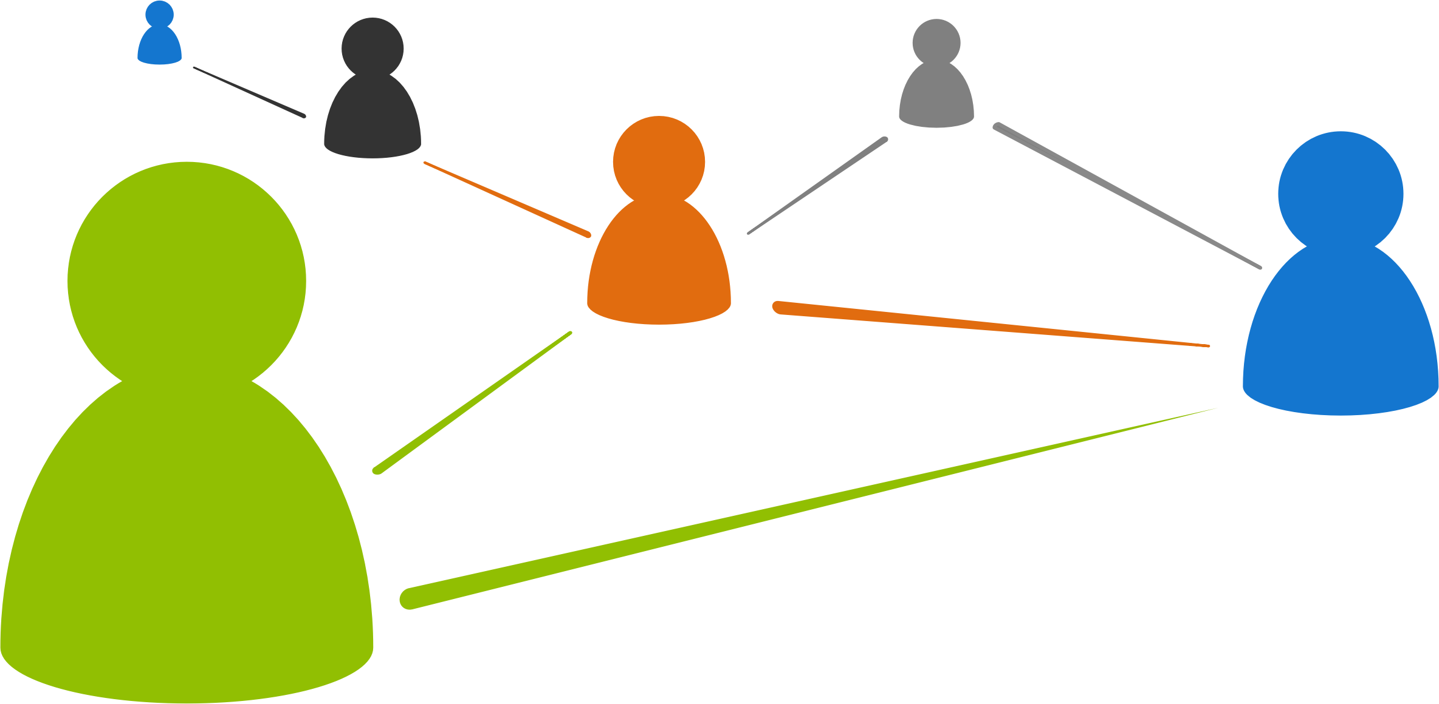

AWS Rekognition Video
Public safety
Recognize a person of interest across a collection of millions in real time across hundreds of cameras
Track a person of interest across a video
Create alerts by detecting objects and activities of interest, such as a car, license plate, running, etc.
Notes:
In public places where there are authorized cameras
Immediate response
Protect a celebrity
Alert forces about a person of interest
After an event has happened – gather videos from multiple sources and track a how a person has moved around
Reconstruct what has happened
Problem - might have 10 000 hours of video, manually impossible, so they do sampling
Restricted area and a car comes in which has an unrecognized license plate
Can again create notifications or alert based on this, I am seeing a car which is not supposed to be here

Slide 37
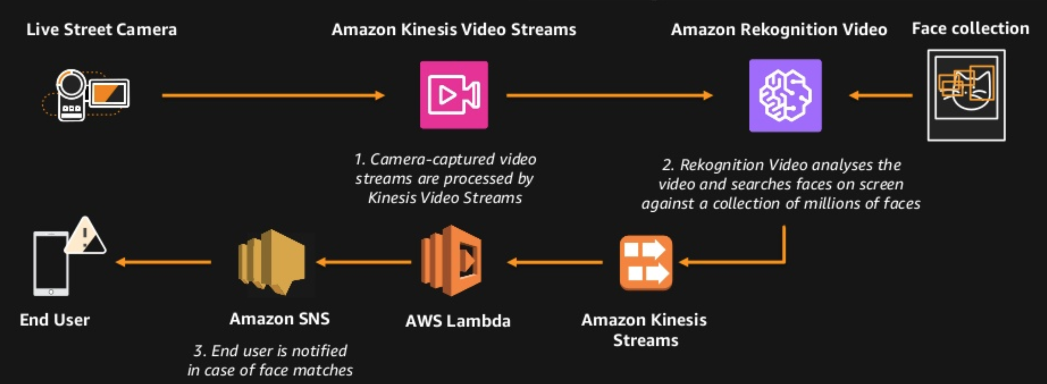
AWS Rekognition Video
Use case: Live recognition of Persons of Interest
Notes:
Live stream analysis architecture example.

Slide 38


AWS Rekognition Video
Home monitoring
Face recognition for door-bell cameras
Detect activities from home cameras
Notes:
Monitor children or old people and their activities, for example call an ambulance if necessary.
Monitor against burglaries, intruders.
Monitor for guests etc.

Slide 39
AWS Rekognition Video
Pricing
Video analysis
$0.10/min of video processed for video API
Stream analysis
$0.12/min of video processed for streaming API

Slide 41
Other points of interest

Slide 42
Rre:invent 2017 other cool bits
Getting Started with Amazon Aurora - Breakout Session
A Day in the Life of a Netflix Engineer III - Breakout Session
AWS Neptune Graph Database - LAB
Capturing Voice Input in a Browser and Sending it to Amazon Lex – Chalk Talk

Slide 43

Rre:invent 2017 other cool bits
Notes:
My presentation on this is in the reference links slide.

Slide 44
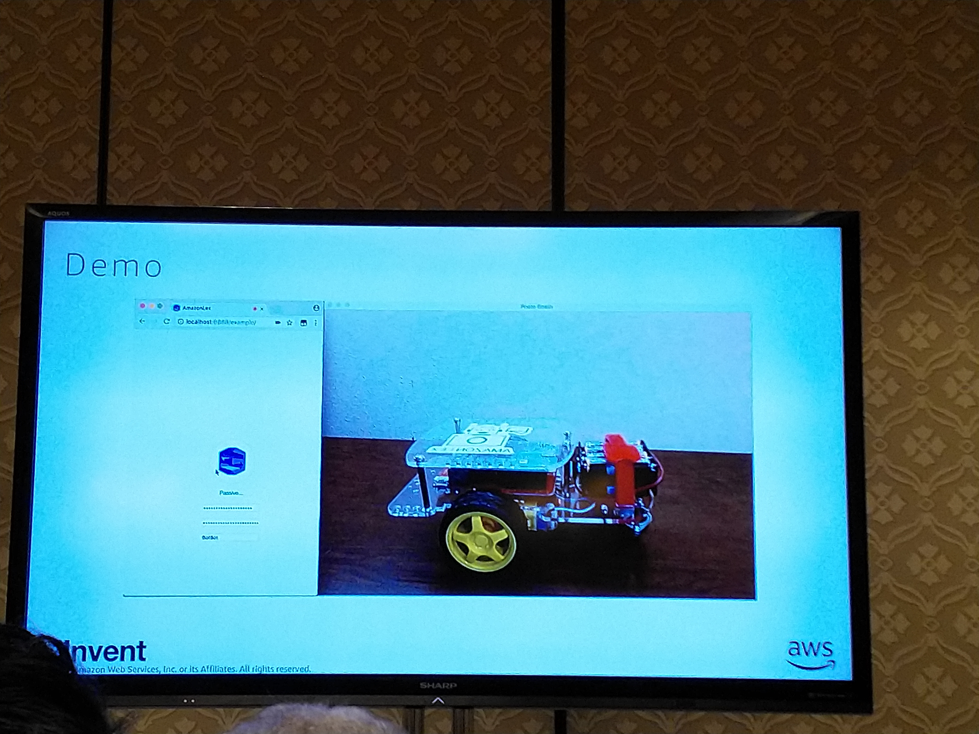
Rre:invent 2017 other cool bits
Capturing Voice Input in a Browser and Sending it to Amazon Lex
Notes:
Used AWS Lex to build a browser app to control a remote controlled car / robot via voice.

Slide 45
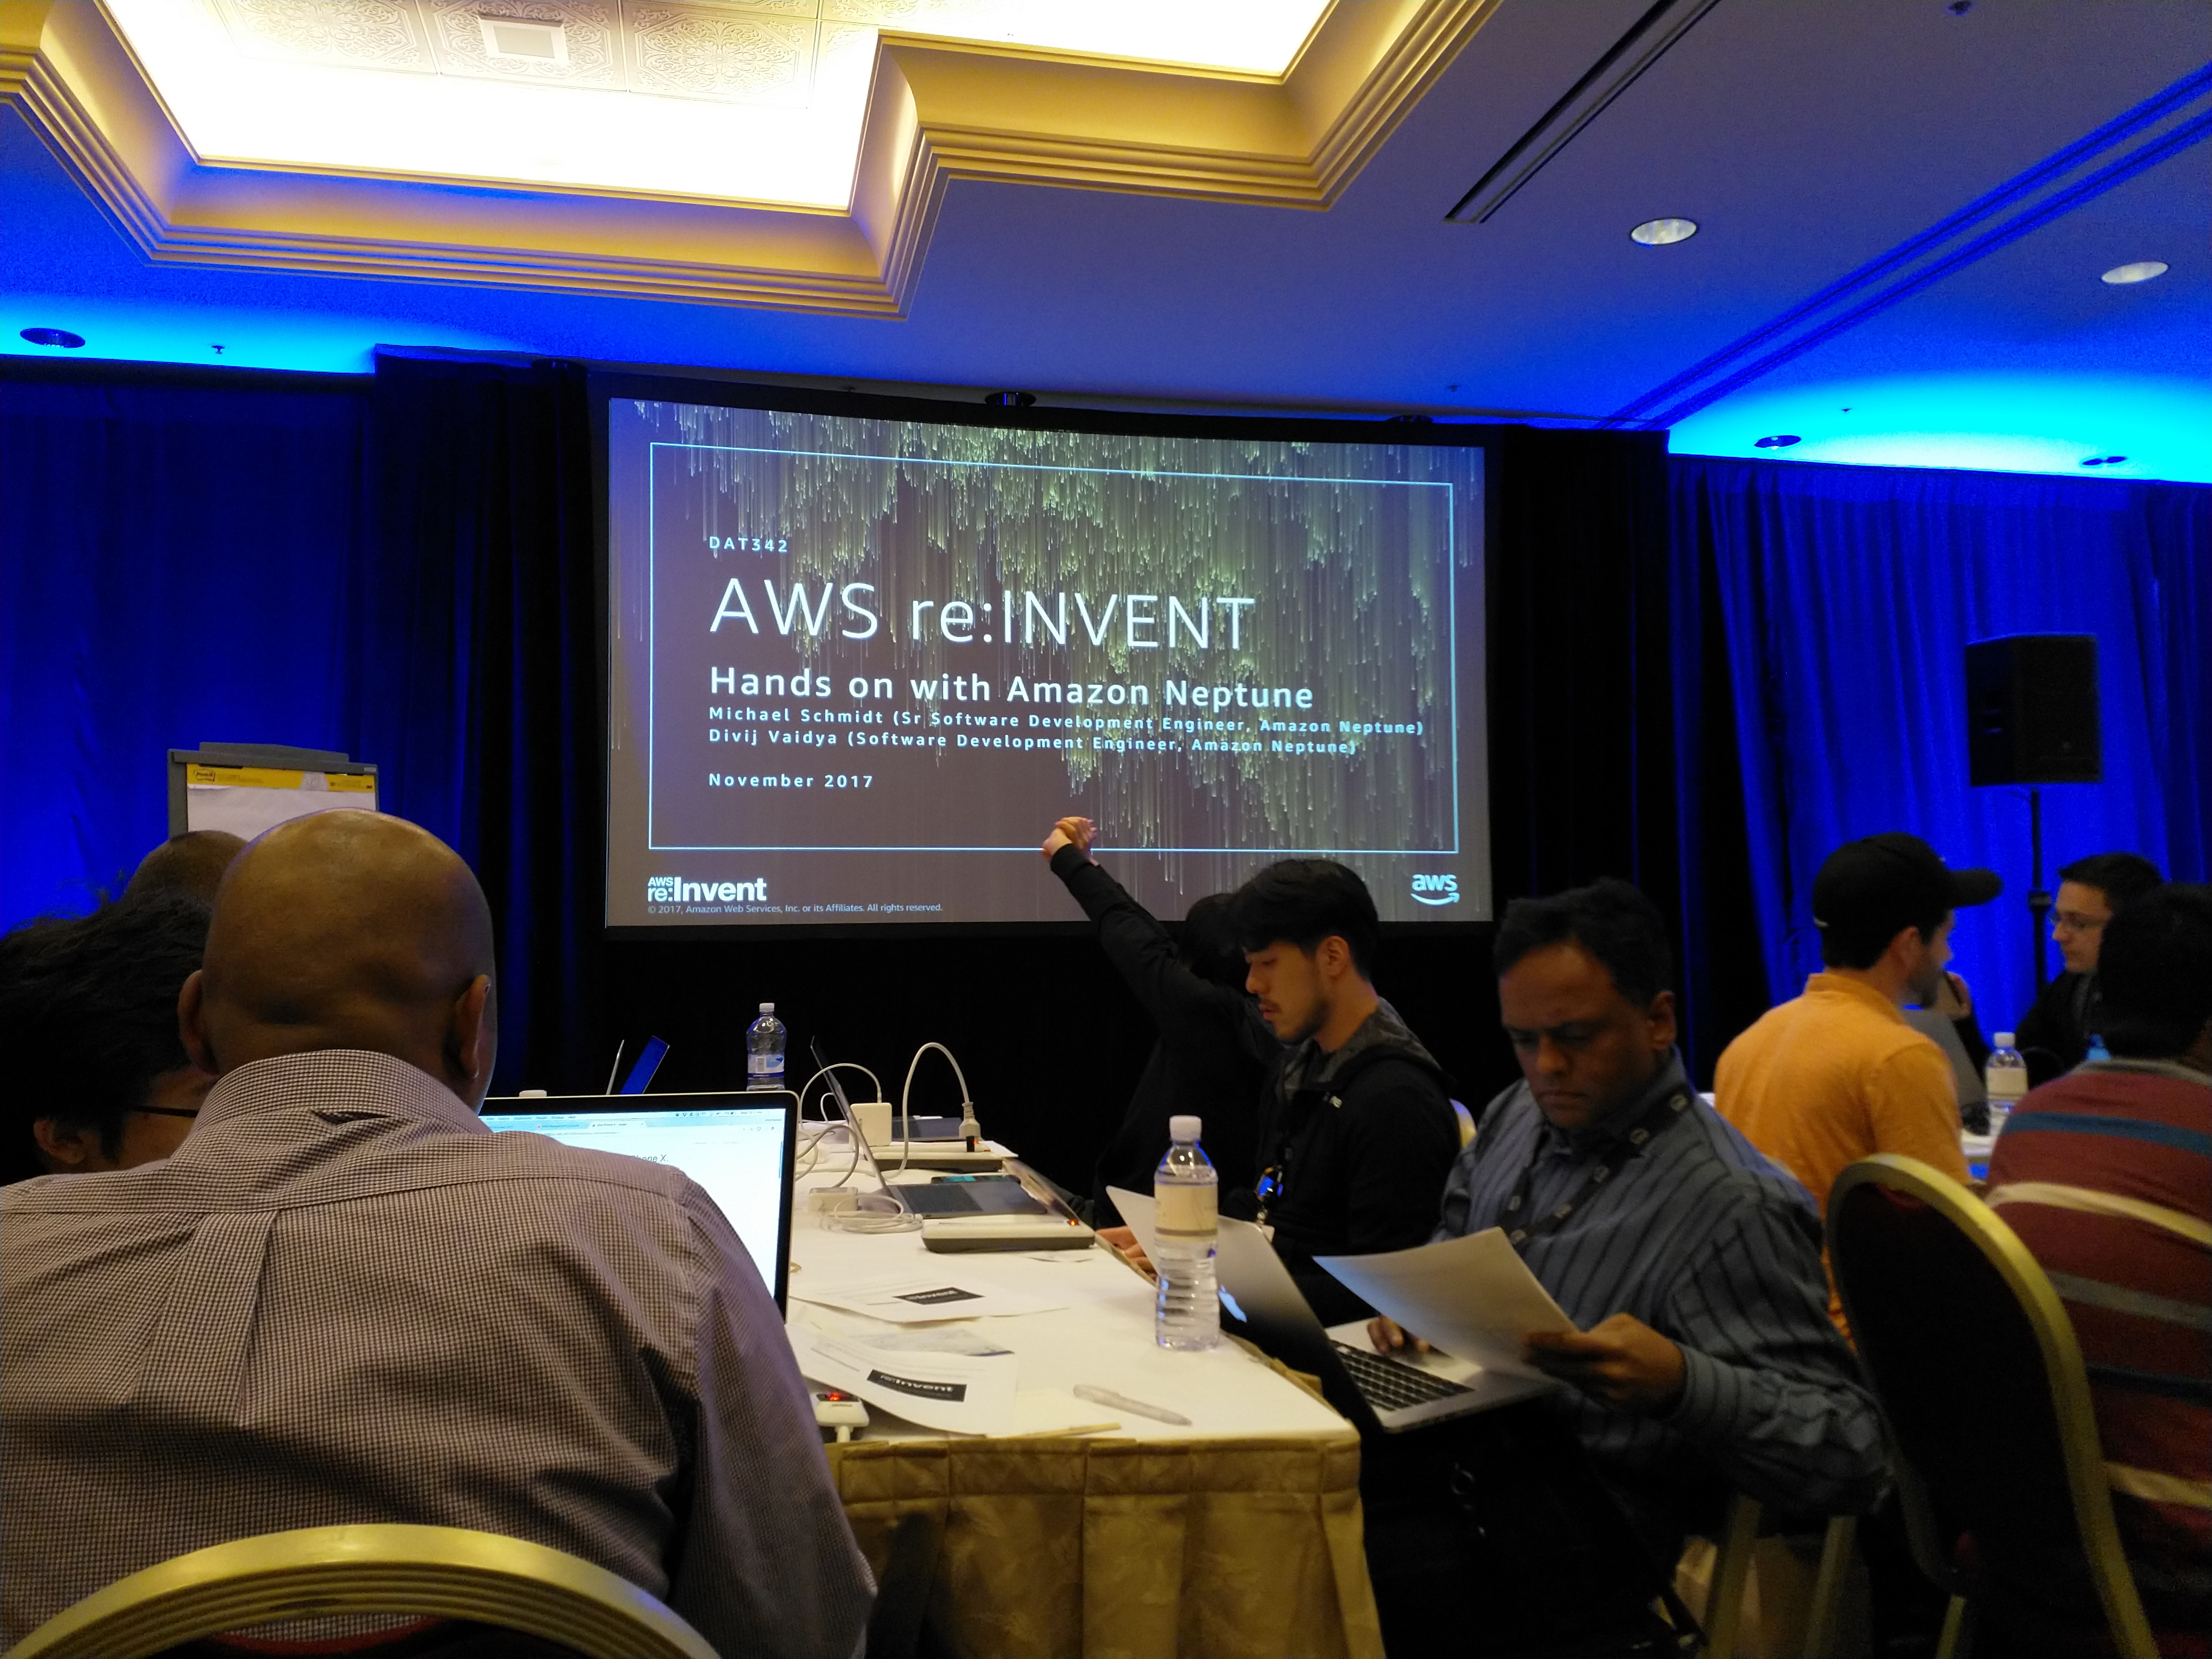
Rre:invent 2017 other cool bits
AWS Neptune Graph Database – hands on LAB

Slide 46
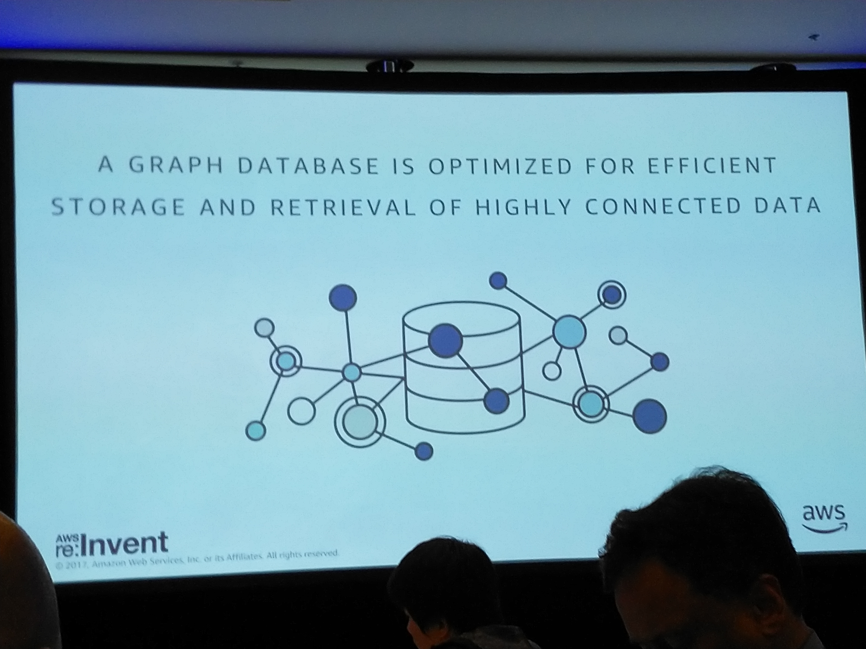
Rre:invent 2017 other cool bits

Slide 48


Slide 49


Slide 50
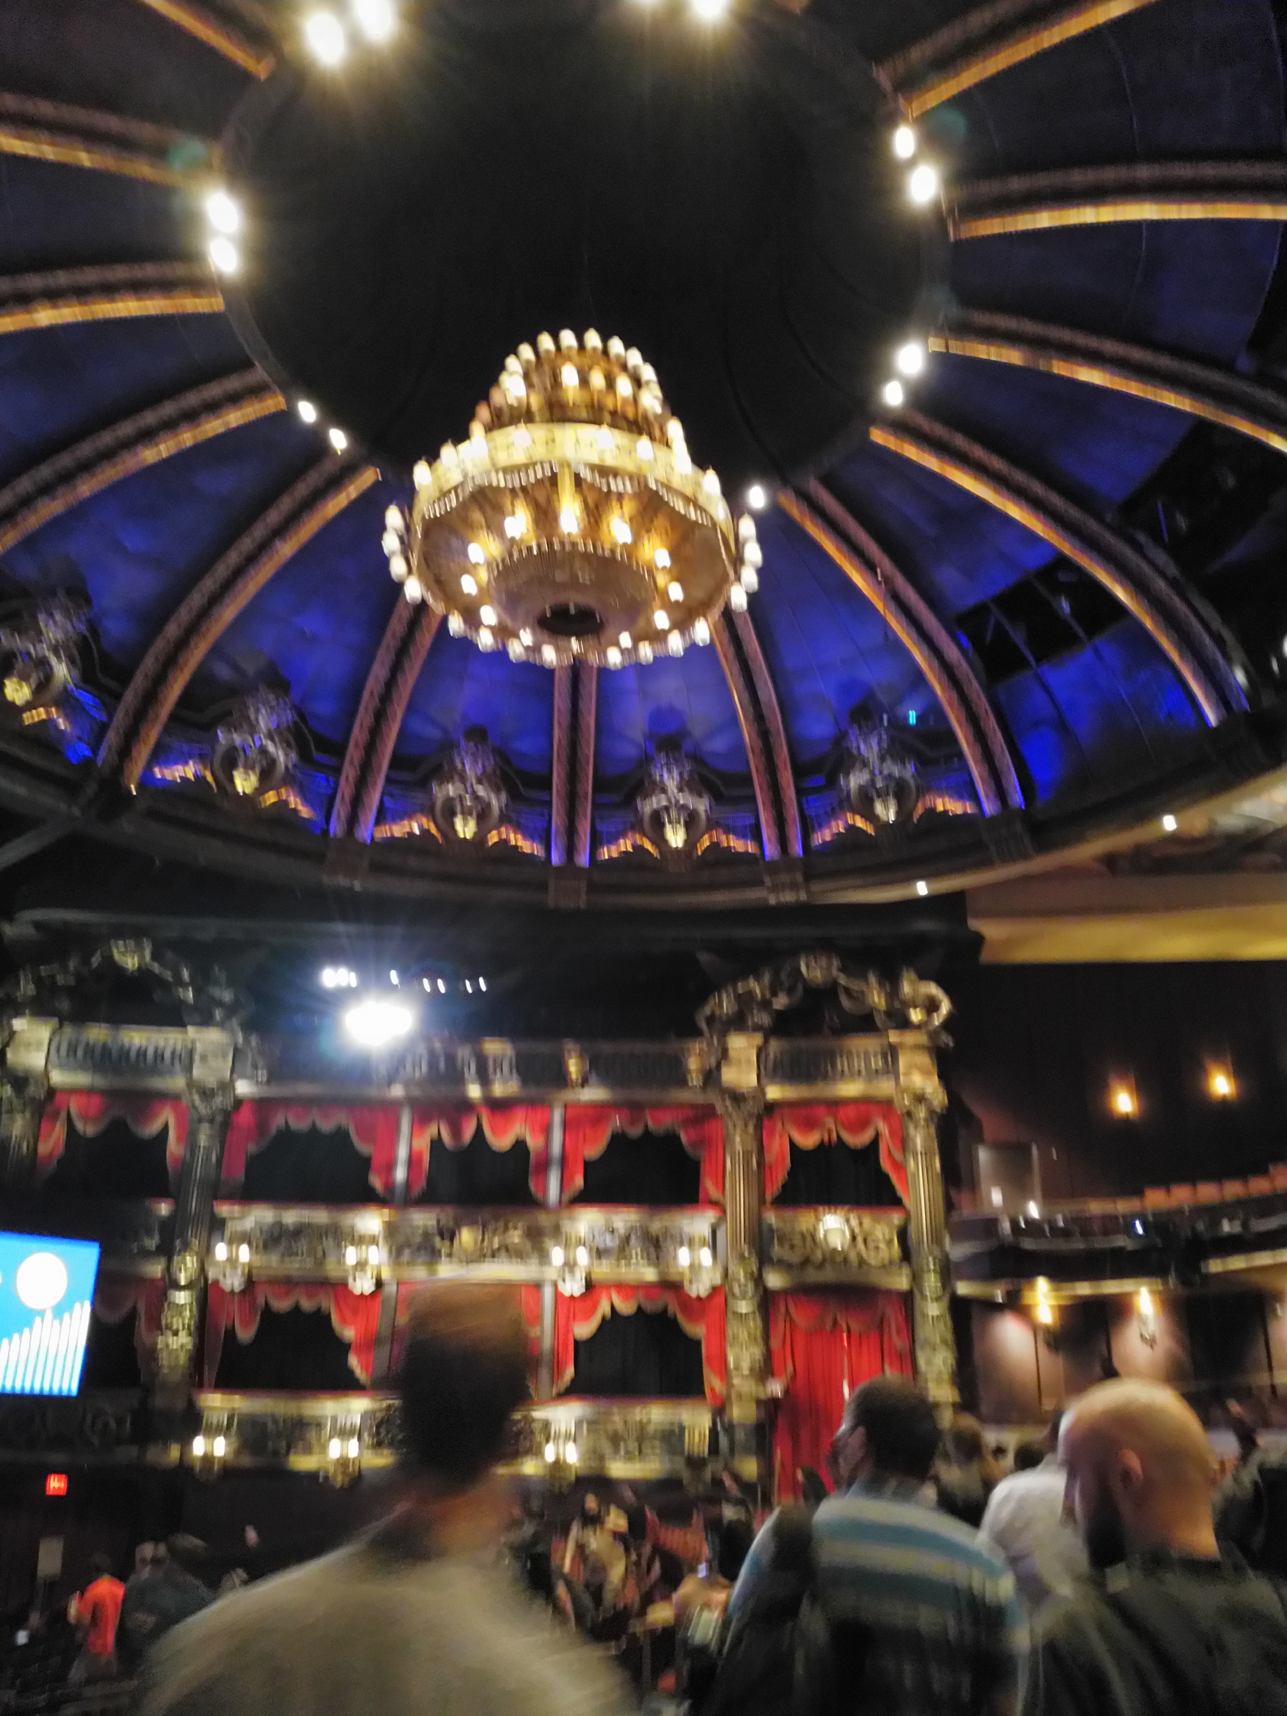

Slide 51
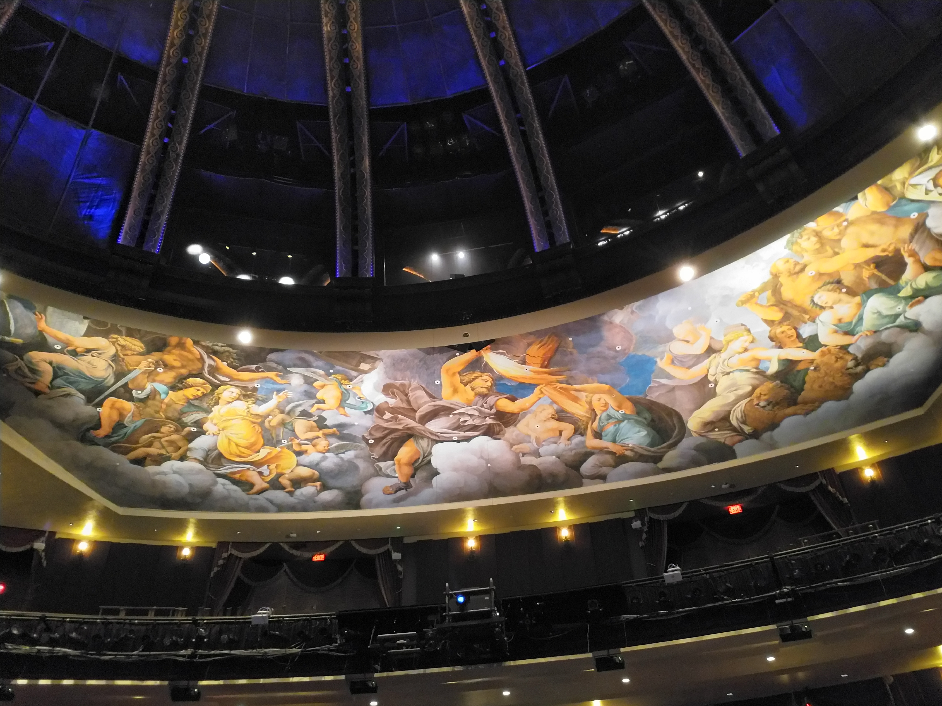

Slide 52
A Day in the Life of a Netflix Engineer III

Slide 53

A Day in the Life of a Netflix Engineer III

Slide 55
A Day in the Life of a Netflix Engineer III

Slide 56

A Day in the Life of a Netflix Engineer III

Slide 57
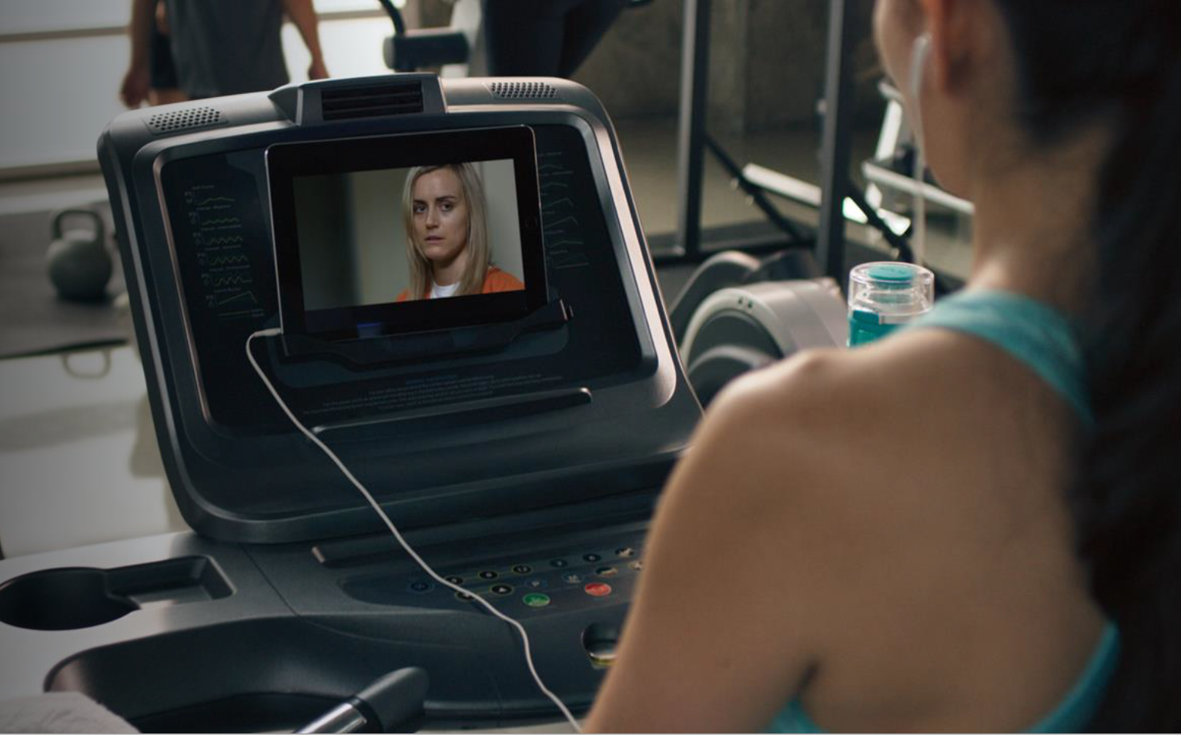

A Day in the Life of a Netflix Engineer III

Slide 58
A Day in the Life of a Netflix Engineer III

Slide 59

A Day in the Life of a Netflix Engineer III

Slide 60


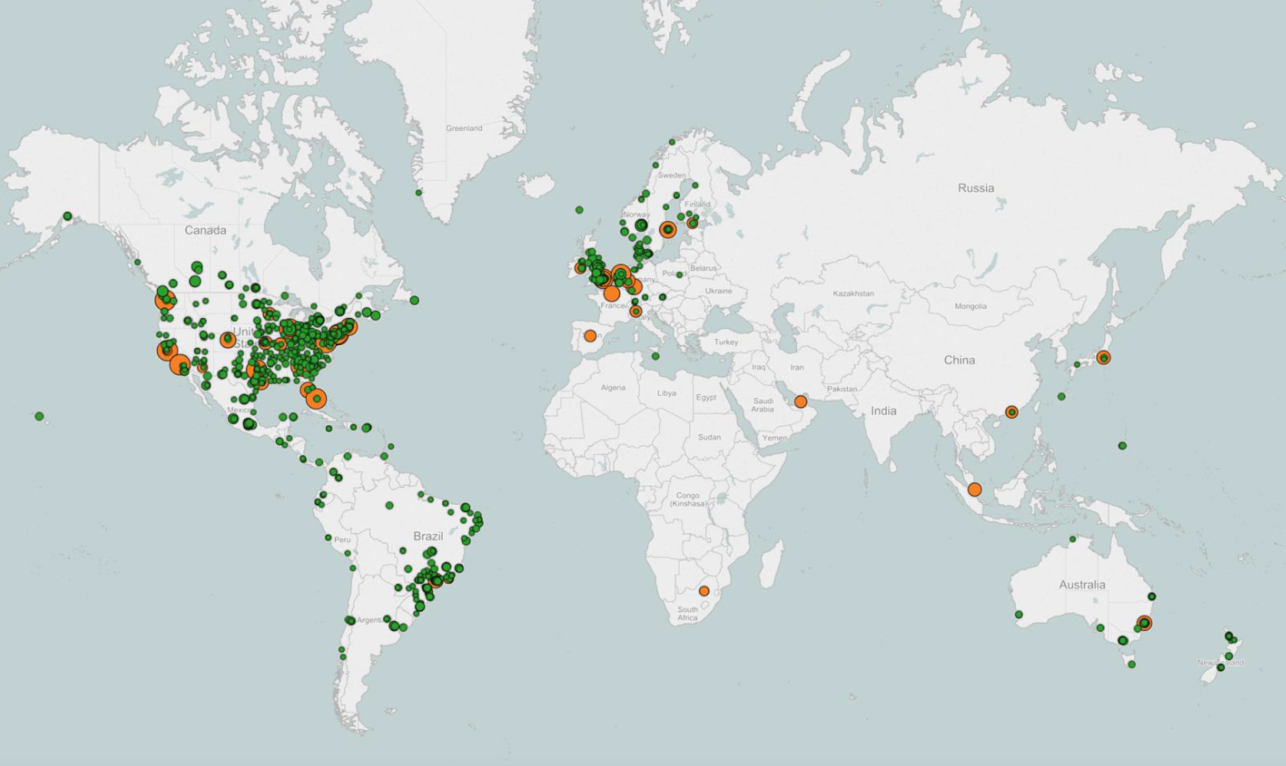
A Day in the Life of a Netflix Engineer III

Slide 62
Demo

Slide 63
References
Links:
https://aws.amazon.com/rekognition/
https://www.slideshare.net/AmazonWebServices/new-launch-amazon-rekognition-video-eliminates-manual-cataloging-of-video-which-is-expensive-errorprone-and-hard-to-scale-mcl339-reinvent-2017
https://aws.amazon.com/ecs/
https://www.slideshare.net/AmazonWebServices/con202getting-started-with-docker-and-amazon-ecs?from_action=save
https://www.youtube.com/user/AmazonWebServices/playlists?shelf_id=27&view=50&sort=dd
https://confluence.dev.bbc.co.uk/display/~atanas.kuzmanov@bbc.co.uk/Atanas+Presentations

Slide 64

Questions?

Slide 65
The end
Thank you!

